Slide 1
Lecture 4: Enterprise Data Warehouse Bus Architecture
Chapter 4

Slide 2
Introduction
Enterprise data warehouse bus architecture: enterprise data warehouse bus architecture
A bus is a common structure to which everything connects and from which everything derives power.
All the processes of an organization’s value chain create a family of dimensional models that share a set of common, conformed dimensions.
The enterprise data warehouse bus architecture provides a rational approach to decomposing the enterprise DW/BI planning task.
The bus architecture is independent of technology and database platforms.

Slide 3
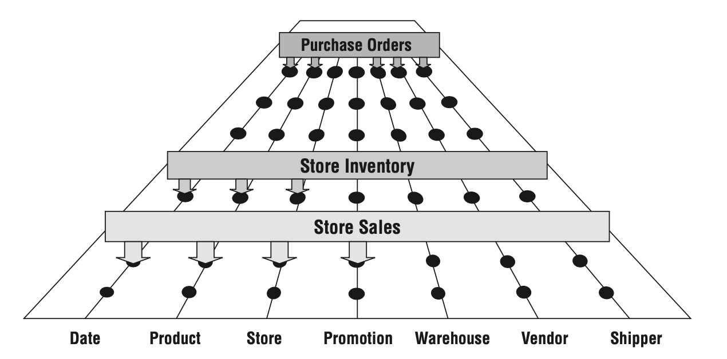
Enterprise data warehouse bus with shared dimensions

Slide 4
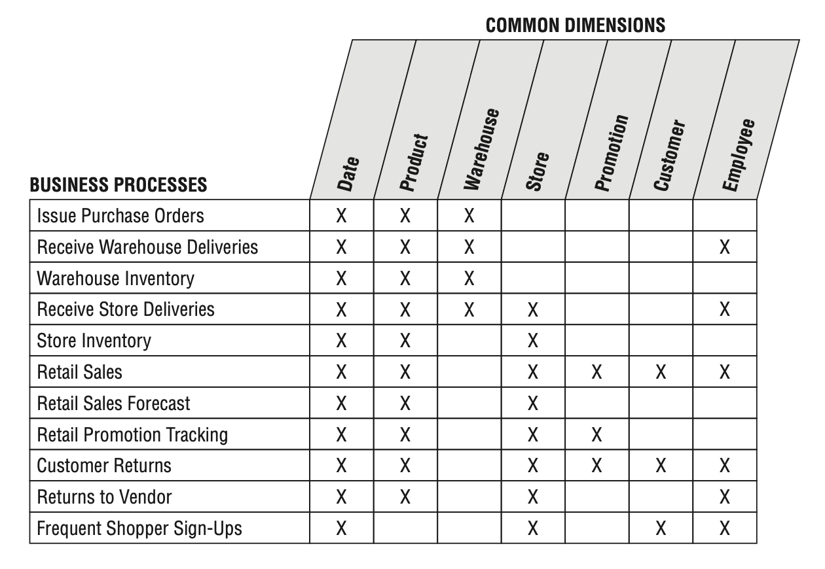
Enterprise Data Warehouse Bus Matrix
The organization’s business processes are represented as matrix rows.
The columns of the bus matrix represent the common dimensions used across the enterprise.

Slide 5
Multiple Matrix Uses
Architecture planning and Database design: The matrix delivers the big picture perspective, regardless of database or technology preferences.
Data governance coordination: Shared dimensions supply potent integration glue, allowing the business to drill across processes.
Project estimating and Organizational communication: The matrix enables groups to communicate effectively within and across data governance and DW/BI teams.

Slide 6
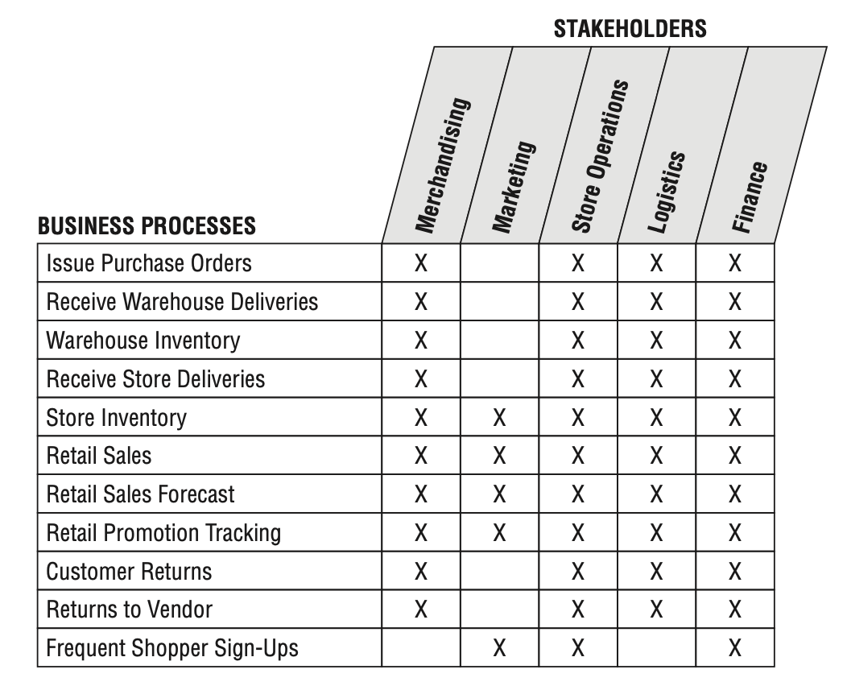
Opportunity/Stakeholder Matrix
Dimension columns are business functions;
merchandising, marketing, store operations, and finance
Identifies which groups need to be invited to the detailed requirements, dimensional modeling, and BI application specification parties;

Slide 7
Common Bus Matrix Mistakes
When struggle with the level of detail expressed by each row:
Departmental or overly encompassing rows:
the matrix rows shouldn’t correspond to the boxes on a corporate organization chart representing functional groups.
Report-centric or too narrowly defined rows:
the matrix row should reference the business process, not the derivative reports or analytics.
Overly generalized columns.
Separate columns for each level of a hierarchy.

Slide 8
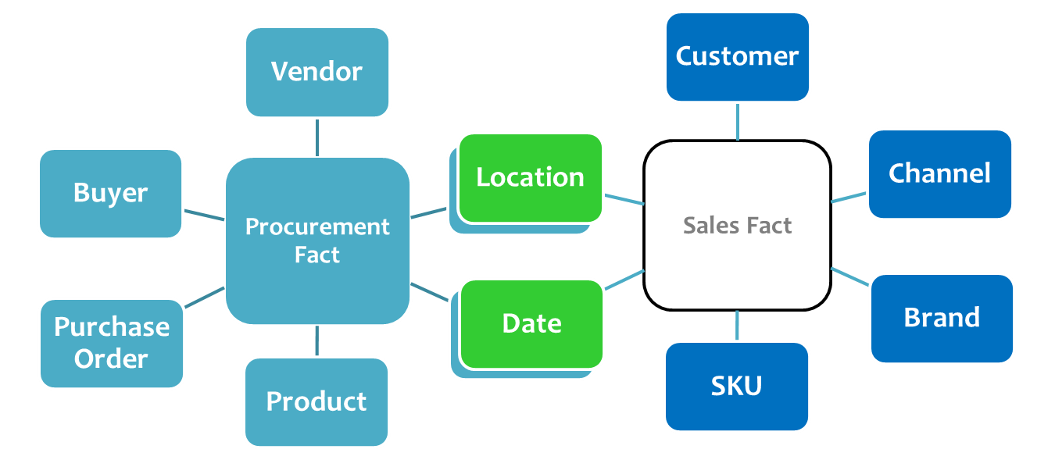
Conformed Dimensions
Dimension tables conform when attributes in separate dimension tables have the same column names and domain contents.
Conformed dimensions, deﬁned once in collaboration with the business’s data governance representatives, are reused across fact tables;
Known as common dimensions, master dimensions, reference dimensions, and shared dimensions.

Slide 9
Drilling Across Fact Tables
Drilling across means making separate queries against two or more fact tables where the row headers of each query consist of identical conformed attributes.
The answer sets from the two queries are aligned by performing a sort-merge operation on the common dimension attribute row headers.
BI tool vendors refer to this functionality by various names, including stitch and multipass query.

Slide 10
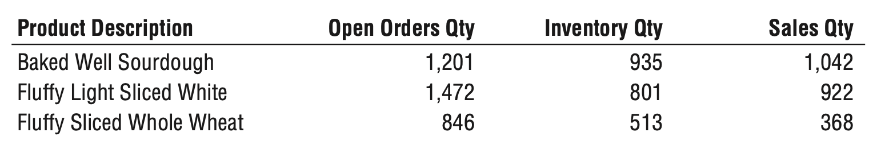
Drilling across fact tables with conformed dimension attributes.
Use multipass SQL to query each dimensional model separately and then outer-join the query results based on a common dimension attribute, such as product name.

Slide 11
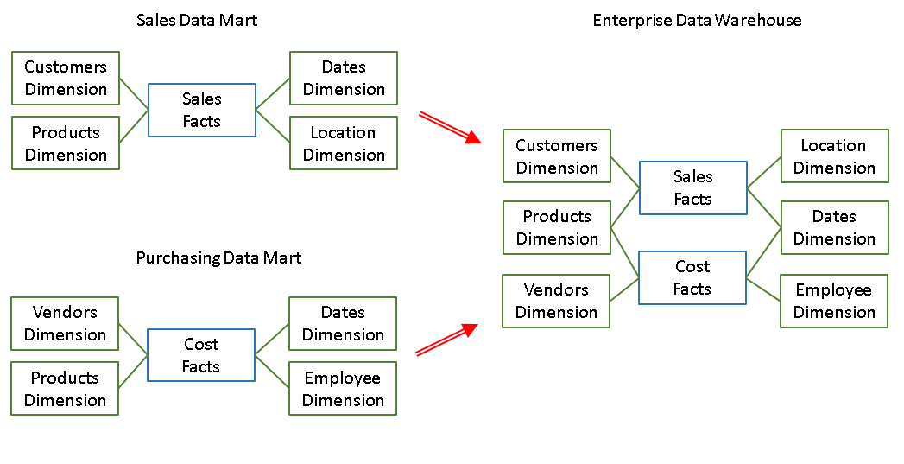
Identical Conformed Dimensions
Identical conformed dimensions have consistent dimension keys, attribute column names, attribute definitions, and attribute values (which translate into consistent report labels and groupings).
The date dimension table connected to the sales facts is identical to the date dimension table connected to the inventory facts.

Slide 12
Identical Conformed Dimensions
Dimension attributes don’t conform if they’re called Month in one dimension and Month Name in another; likewise, they don’t conform if the attribute value is “July” in one dimension and “JULY” in another.
Dimension is built once in the ETL system and then duplicated synchronously outward to each dimensional model.
the same number of rows, same key values, same attribute labels, same attribute data definitions, and same attribute values.
Sometimes dimensions at the same level of granularity do not fully conform.
For example, product and store attributes needed for inventory analysis, but aren’t appropriate for analyzing retail sales data.

Slide 13
Shrunken Rollup Conformed Dimension (Attribute Subset or Row Subset)
Shrunken dimensions are conformed dimensions that are a subset of rows and /or columns of a base dimension.
When do we need Shrunken rollup dimensions:
When constructing aggregate fact tables;
When capture data at a higher level of granularity, such as a forecast by month and brand (instead of the more atomic date and product associated with sales data);
When two dimensions are at the same level of detail, but one represents only a subset of rows.

Slide 14
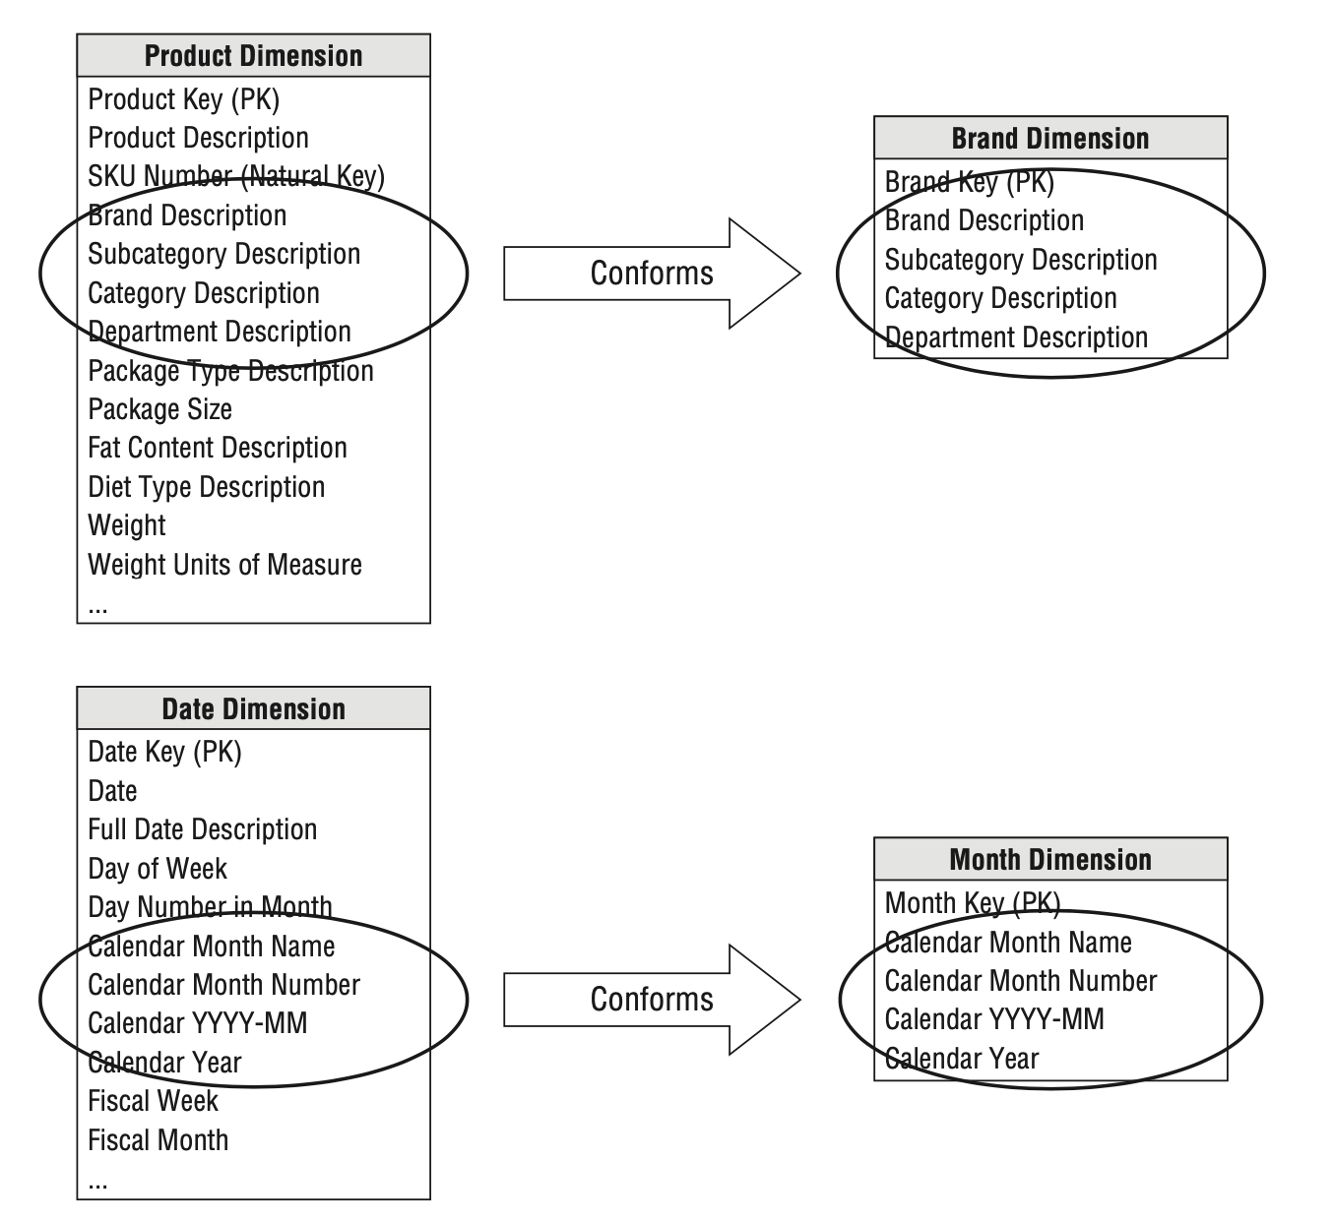
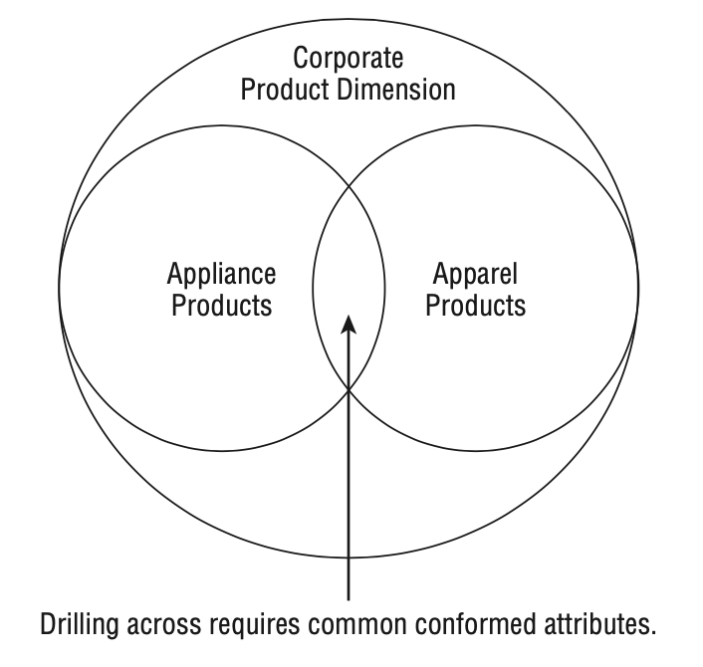
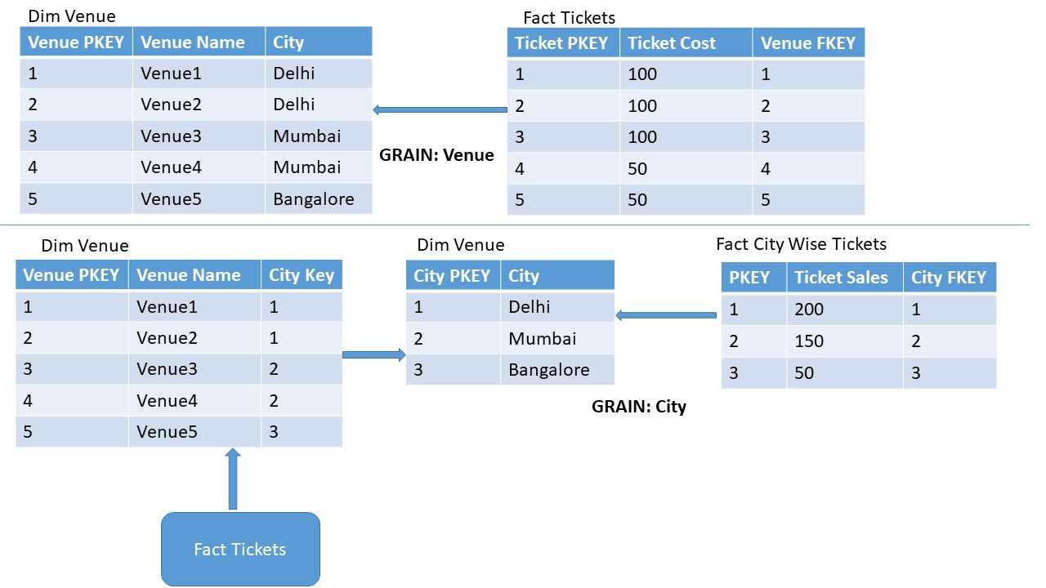
Shrunken Rollup Conformed Dimension

Slide 15
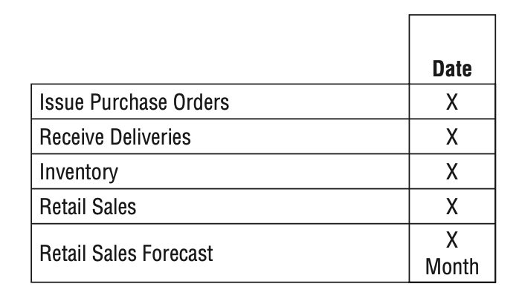
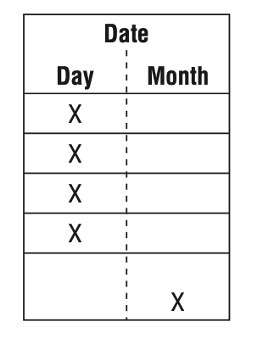
Shrunken Conformed Dimensions on the Bus Matrix
Mark the cell for the atomic dimension, but then textually document the rollup or row subset granularity within the cell.
Subdivide the dimension column to indicate the common rollup or subset granularities.

Slide 16
Importance of Data Governance and Stewardship
Business-Driven Governance Characteristics:
Respect from the organization
Broad knowledge of the enterprise’s operations
Ability to balance organizational needs against departmental requirements
Gravitas and authority to challenge the status quo and enforce policies
Strong communication skills
Politically savvy negotiation and consensus building skills
Governance Objectives
To reach agreement on data definitions, labels, and domain values so that everyone is speaking the same language;
To establish policies and responsibilities for data quality and accuracy, as well as data security and access controls;

Slide 17
Conformed Fact
Conformed facts are:
Facts of the same measurement used living in more that one data model.
Same rules and characteristics apply in designing and implementing them as with conformed dimensions;
Same units of measure for the fact;
Identical labeling;
Underlying definitions and equations

Slide 18
Conformed Fact
If the same measurement appears in separate fact tables, care must be taken to make sure the technical deﬁnitions of the facts are identical if they are to be compared or computed together.
If the separate fact deﬁnitions are consistent, the conformed facts should be identically named;
If they are incompatible, they should be differently named to alert the business users and BI applications.

